Slide 1

FILL IN WITH TEXT
Steering Horizon Controller CORE/CDX746/7 UPV0 status updated
Richard Li – Feature Owner
Brian Atherton – Feature Owner
Lisa Waszczenko - Supervisor
02/22/2021

Slide 2

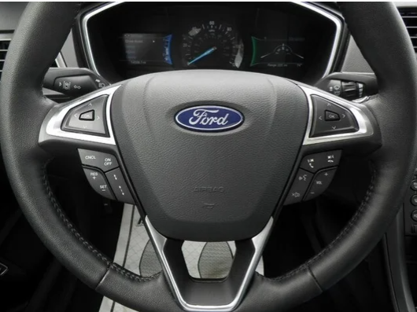
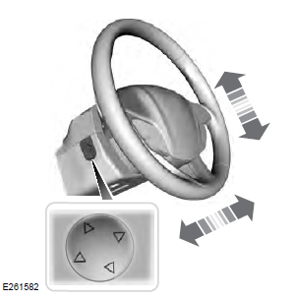
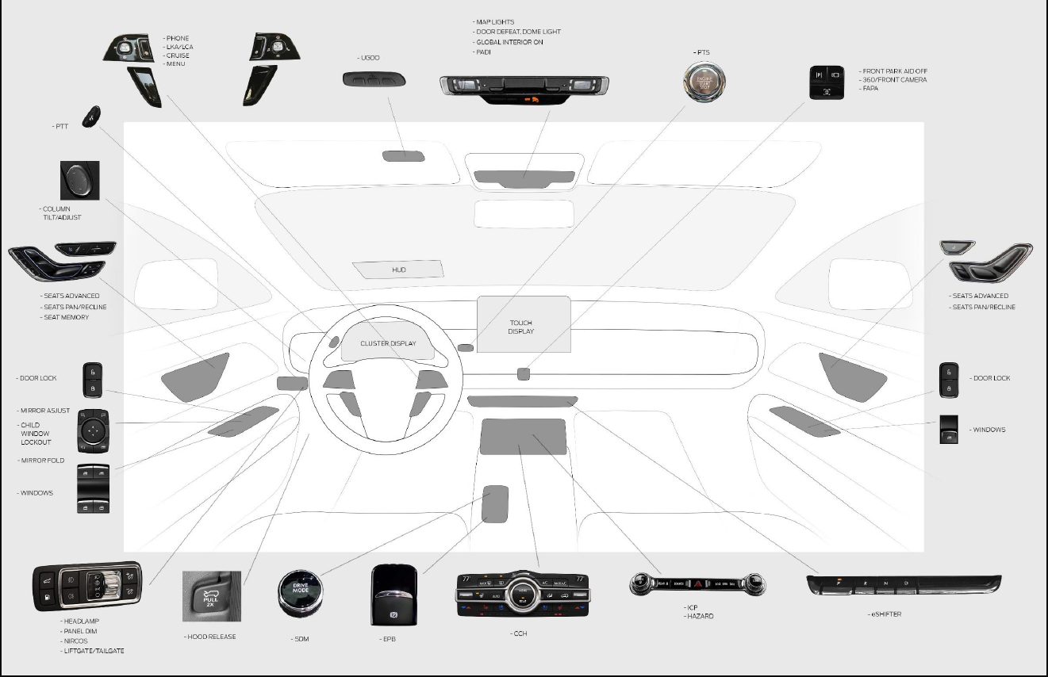

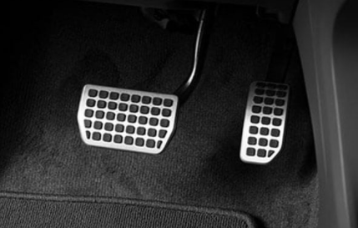
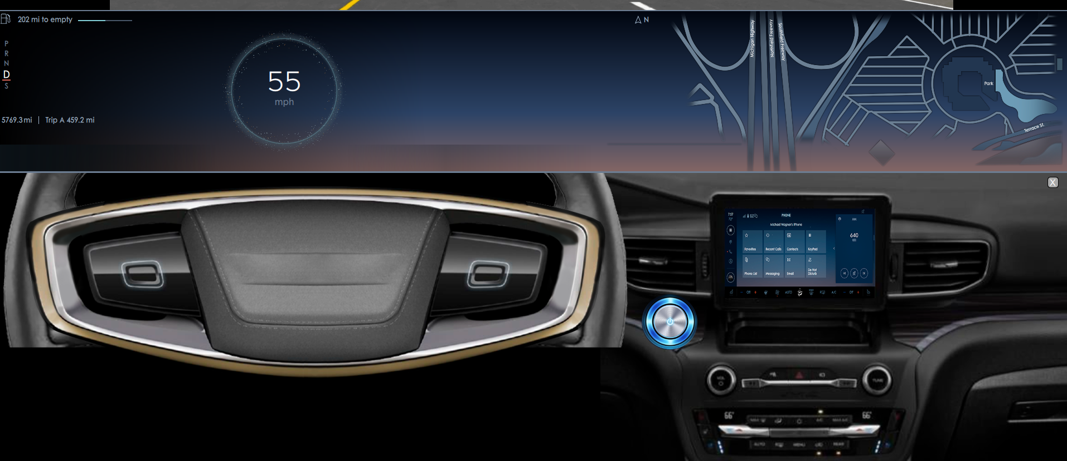
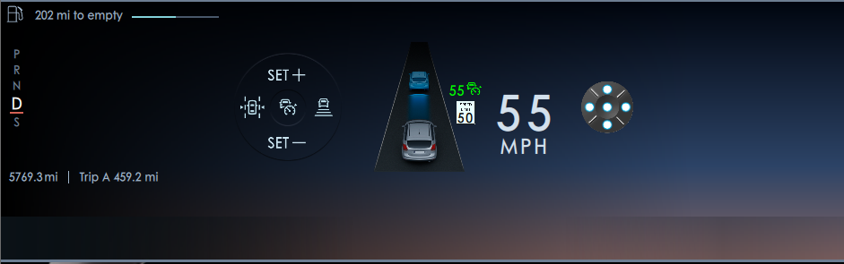

Concept - Steering Horizon Controller
Summary of the Change
Definition of the Change/Problem: | The Driver needs to reach multiple switches from different locations to perform cruise control, adjust/fold rear mirrors, adjust steering column and pedals. CIED desires a programmable switch interface on the steering wheel to maintain line of sight on the high heads up display.
Description of the Proposed Changes: | Combined Cruise Control with Mirror adjust & fold, steering column control and adjustable pedal on the steering Horizon Controller AND show on DISPLAY. Utilized Phoenix domain controller to translate switch inputs to menu/icon on display and perform switch input logic to determine CAN signals to features actuators.
Justification why the proposed changes should be implemented: | protecting eyes up and out – ALL Control content consistently show on display Reducing operating complexity – Combining four around switches to current steering wheel switches. Reducing hardware and JITs cost - eliminating ACC, Mirror, Column and Pedal four sets Switches Increasing interior Enjoyable experience – Streamlined design More Capacity – Through add menu /ICON to control more features
Current Strategy
Current Strategy
B
C
B
A
D
A
C
New Strategy
E
D
Tilt / Tele
A
B C D
Proposal
Using configurable switch interface to Combine Cruise Control (A) with Mirror ADJUST & MIRROR FOLD (B), steering column control (C) AND ADJUSTABLE PEDAL(D) on the steering Horizon Controller AND show on DISPLAY (E).
Benefits
protecting eyes up and out – ALL Control content consistently show on display
Reducing operating complexity – Combining Seven around switches to current steering wheel switches.
Reducing hardware and JITs cost - eliminating ACC, Mirror, Column and Pedal five sets Switches
Increasing interior Enjoyable experience – Streamlined design
More Capacity – Through add menu /ICON to control more features

Slide 3
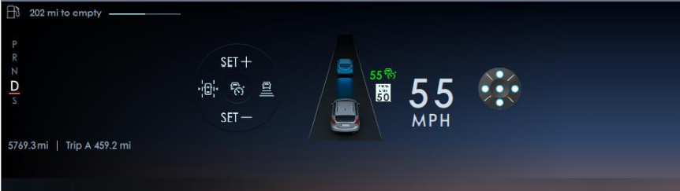

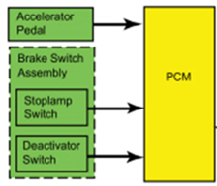

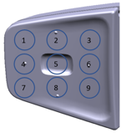

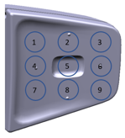

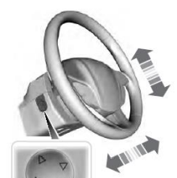



Improved Steering Horizon Controller Boundary Diagram
Customer Output
Customer Input – Switch button push
Phoenix Domain Controller
Lpos_1
Lpos_2
Lpos_3
Lpos_4
Lpos_5
Lpos_6
Lpos_7
Lpos_8
Lpos_9
Lprespos_1
Lprespos_2
Lprespos_3
Lprespos_4
Lprespos_5
Lprespos_6
Lprespos_7
Lprespos_8
Lprespos_9
DAT-ACC
on
off
Can
Lateral Control
Res +
Set -
Gap
Switch status signals
Cruise Control Network Diagram
CC Actuator
Feature actuation signals
Menu
Menu
Menu up
Menu down
OK
RADIO/PPT
PPT
Vol +
Vol -
Seek left
Seek right
Phone
Phone - Accept
Phone - Reject
Vol +
Vol -
St Column
Tilt +
Tilt -
Tele +
Tele -
Mirror LH
Tilt +
Tilt -
Tele +
Tele -
Mirror RH
Tilt +
Tilt -
Tele +
Tele -
HS3-CAN
PCM
HS1-CAN
Private
CAN
ECG2
Enhance central Gateway
SIMA
Switch input Module A
HS2-CAN
Power Adjustable Mirrors and Fold Mirrors (w/ Autofold)
Mirror Actuator
SCCM
Steer Column Control Module
FD3-CAN
FD3-CAN
DDM
Driver Door Control Module
BCM
Body Control Module
PC Actuator
Rpos_1
Rpos_2
Rpos_3
Rpos_4
Rpos_5
Rpos_6
Rpos_7
Rpos_8
Rpos_9
Rprespos_1
Rprespos_2
Rprespos_3
Rprespos_4
Rprespos_5
Rprespos_6
Rprespos_7
Rprespos_8
Rprespos_9
Power Column (tilt/tele) Network Diagram
Summary
Utilized Phoenix domain controller to to translate 18 switch signal logic combination to more 60 CAN signals.
No need new ECU module.
FD3-CAN
DDM
Driver Door Control Module
DSM
Driver seat control module
Power Pedal (Tilt) network Diagram
Pedal Actuator
FD3-CAN
DDM
Driver Door Control Module
DSM
Driver seat control module

Slide 4
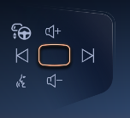
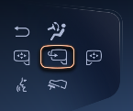
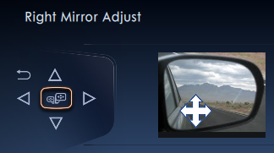
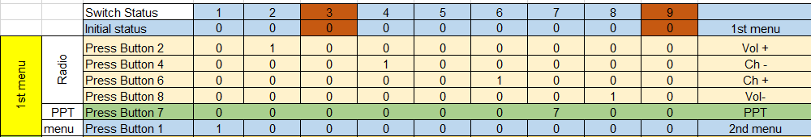
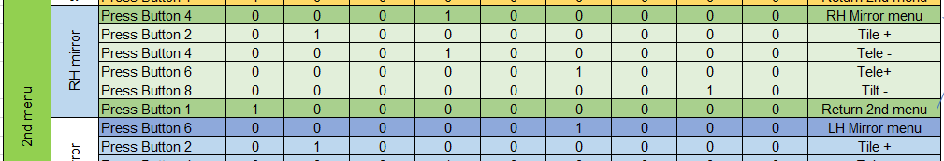
How Horizon Controller Works?
5
= Logic Ops(1,2,3,4) = (RH Mirror Tilt -)
Customer
Lpos_1
Lpos_2
Lpos_3
Lpos_4
Lpos_5
Lpos_6
Lpos_7
Lpos_8
Lpos_9
Lprespos_1
Lprespos_2
Lprespos_3
Lprespos_4
Lprespos_5
Lprespos_6
Lprespos_7
Lprespos_8
Lprespos_9
DAT-ACC
on
off
Can
Lateral Control
Res +
Set -
Gap
Phoenix Domain Controller
1
2
3
Switch status signals
Touch anywhere on switch to wake up screen
Feature actuation signals
Menu
Menu
Menu up
Menu down
OK
RADIO/PPT
PPT
Vol +
Vol -
Seek left
Seek right
Phone
Phone - Accept
Phone - Reject
Vol +
Vol -
St Column
Tilt +
Tilt -
Tele +
Tele -
Mirror LH
Tilt +
Tilt -
Tele +
Tele -
Mirror RH
Tilt +
Tilt -
Tele +
Tele -
HS3-CAN
4
1
2
3
4
ECG2
HS1-CAN
Power Adjustable Mirrors and Fold Mirrors (w/ Autofold)
HS2-CAN
Mirror Actuator
SIMA
SCCM
FD3-CAN
DDM
BCM
Private
CAN
5
Rpos_1
Rpos_2
Rpos_3
Rpos_4
Rpos_5
Rpos_6
Rpos_7
Rpos_8
Rpos_9
Rprespos_1
Rprespos_2
Rprespos_3
Rprespos_4
Rprespos_5
Rprespos_6
Rprespos_7
Rprespos_8
Rprespos_9

Slide 5
Steering Horizon Controller Major Change Point Analysis
Phoenix Domain Controller
Customer
1. Switch – J. Murphy, R. Kern, S Magiera
1.1. New design w/new signals – From 7 sets of switches to 2 sets of switches.
1.2. Multi function switch.
1.3. Increase durability cycles.
1.4. Worst case study – Abuse loading
3. STSS IVI – G. Cheng, R. Paquette
ECG2 & Phoenix Domain Controller spec
6. IVIC, BD - Hamid Mahmood, Joey Oravec
Switch status signals
Feature actuation signals
4. Display Cluster – J. Gregoire, J. Asirvatham
Handle menu & ICON on display based on switch input.
7. EESE Physical Architecture -
7. EESE Physical Architecture – Z Deljevic , Bruce Williams
Lpos_1
Lpos_2
Lpos_3
Lpos_4
Lpos_5
Lpos_6
Lpos_7
Lpos_8
Lpos_9
Lprespos_1
Lprespos_2
Lprespos_3
Lprespos_4
Lprespos_5
Lprespos_6
Lprespos_7
Lprespos_8
Lprespos_9
8. Software – Anita Stoffer
5. Phoenix Domain Control –
Logic coding based on switch signals to actuator signals.
9. MBSE – Jorge Napoles
HS3-CAN
ECG2
Enhance central Gateway
Cruise Control Network Diagram
CC Actuator
Menu
Menu
Menu up
Menu down
OK
RADIO/PPT
PPT
Vol +
Vol -
Seek left
Seek right
Phone
Phone - Accept
Phone - Reject
Vol +
Vol -
St Column
Tilt +
Tilt -
Tele +
Tele -
Mirror LH
Tilt +
Tilt -
Tele +
Tele -
Mirror RH
Tilt +
Tilt -
Tele +
Tele -
DAT-ACC
on
off
Can
Lateral
Res +
Set -
Gap
HS1-CAN
HS2-CAN
Private
CAN
SCCM
Steer Column Control Module
FD3-CAN
PCM
SIMA
Switch input Module A
Power Adjustable Mirrors and Fold Mirrors (w/ Autofold)
Mirror Actuator
FD3-CAN
DDM
Driver Door Control Module
BCM
Body Control Module
Summary
Utilized Phoenix domain controller to translate switch inputs to menu and icon on display and perform switch input logic to determine CAN signals to features actuators.
No need new module.
2. Need carryover each feature input signals from GWM as ECG2 output signals
PC Actuator
FD3-CAN
Power Column (tilt/tele) Network Diagram
Rpos_1
Rpos_2
Rpos_3
Rpos_4
Rpos_5
Rpos_6
Rpos_7
Rpos_8
Rpos_9
Rprespos_1
Rprespos_2
Rprespos_3
Rprespos_4
Rprespos_5
Rprespos_6
Rprespos_7
Rprespos_8
Rprespos_9
DDM
Driver Door Control Module
DSM
Driver seat control module
FD3-CAN
Power Pedal (Tilt) network Diagram
Pedal Actuator
DDM
Driver Door Control Module
DSM
Driver seat control module
Carryover

Slide 6
5D CDX746/7 Steering Horizon Controller UPV0
Issue Title: | 2024 CDX74X Steering Horizon Controller |  |  | Champion: Team Leader: |  | Sonya Bentley Lisa Waszczenko
Source: |  |  |  | Team: |  | Richard Li, Brian Atherton, Vikram Gokhale
Issue Description: | Unable to meet UPV0 timing for CDX746/7 Steering Horizon Controller features
Containment: | 1- Weekly meetings with FMA team to review updates and complete FMA Documents. 2- Weekly meetings with carryover FOs and Functional Architecture to engineer the interactions between features and ECGs. 3- Weekly meetings with Phoenix, display, Architecture and software teams to manage interface and interactions between features. 4- Weekly meetings with MBSE modeler to finish modeling (Feature Specs). 5- Start meetings with Netcom engineer to create the request for new signals. 6. Review System Latency issue with ECG, phoenix domain controller, Netcom and Functional Arch team; engineer solutions as needed.
Root Cause: | Impacts 746/747. Feature Owners assigned 1/13/21. Feature development started late. Need 5D for UPV0. Find out no new ECU needed Phoenix Domain Controller will process signals /data.
Work Plan: | Steps |  |  |  |  | Target Completion Date |  | Target Completion Date | Lead
 | CDX746/7 Key Dates UPV0 ------------------------------------------------------------------------------------------------------------------------------------ UPV1 ------------------------------------------------------------------------------------------------------------------------------------ UPV2 ------------------------------------------------------------------------------------------------------------------------------------ FDJ --------------------------------------------------------------------------------------------------------------------------------------- DCV -------------------------------------------------------------------------------------------------------------------------------------- UPV0 1- Weekly meetings to address all containment issues (noted above) --------------------------------------------------- 2- Facilitate functional safety status ----------------------------------------------------------------------------------------------- 3- Facilitate cybersecurity ------------------------------------------------------------------------------------------------------------- 4- Provide FMA Status ----------------------------------------------------------------------------------------------------------------- 5- Design Data Analytics -------------------------------------------------------------------------------------------------------------- 6- Request Signals for DCV and Ethernet ----------------------------------------------------------------------------------------- 7- Feature Specs Complete ----------------------------------------------------------------------------------------------------------- 8- Freeze and Cascade Interface Requirements --------------------------------------------------------------------------------- UPV1 1- Create safety V&V report --------------------------------------------------------------------------------------- 2- Create cybersecurity V&V report------------------------------------------------------------------------------ 3- Evolve FMA & communicate status --------------------------------------------------------------------------------------------- |  |  |  |  | 1/27/20 5/22/20 8/26/20 12/11/20 2/17/20 3/26/21 9/27/21 1/27/22 2/18/22 4/11/22 8/22/22 11/27/22 |  | 03/11/21 06/11/21 08/24/21 12/03/21 04/04/22 Ongoing 06/16/21 04/14/21 05/23/21 05/03/21 04/23/21 04/16/21 05/31/21 06/07/21 06/07/21 06/07/21 | R. Li/Team R. Li/FuSa Team R. Li R. Li/FMA Coach R. Li R. Li/Netcom Eng B. Atherton B. Atherton R. Li/FuSa Team R. Li R. Li/FMA Coach
Risk Projections: | UPV0 | UPV1 | UPV2 |  | FDJ |  | Reference #: Date Issued: Date Revised: Date Closed:
 | Major | Minor | Contained |  | Contained
Notes:
Open issues:
* systems application engineering and launch issues

